Slide 1

Prepared by: Heather Grain
Introduction to the
TurboCoder
June 2014

Slide 2
Outline
Getting Started with the TurboCoder
The TurboCoder Main Screen
Searching for codes
Changing the display
Making Notes
Other Features
Notes:
Note: This powerpoint does not explain how to code, simply how to use the eBook tool.

Slide 3

Getting Started
The Icon
Right Click features:
Size – tiny, small, medium, large
Automatic start up
Single Click – opens the TurboCoder

Slide 4
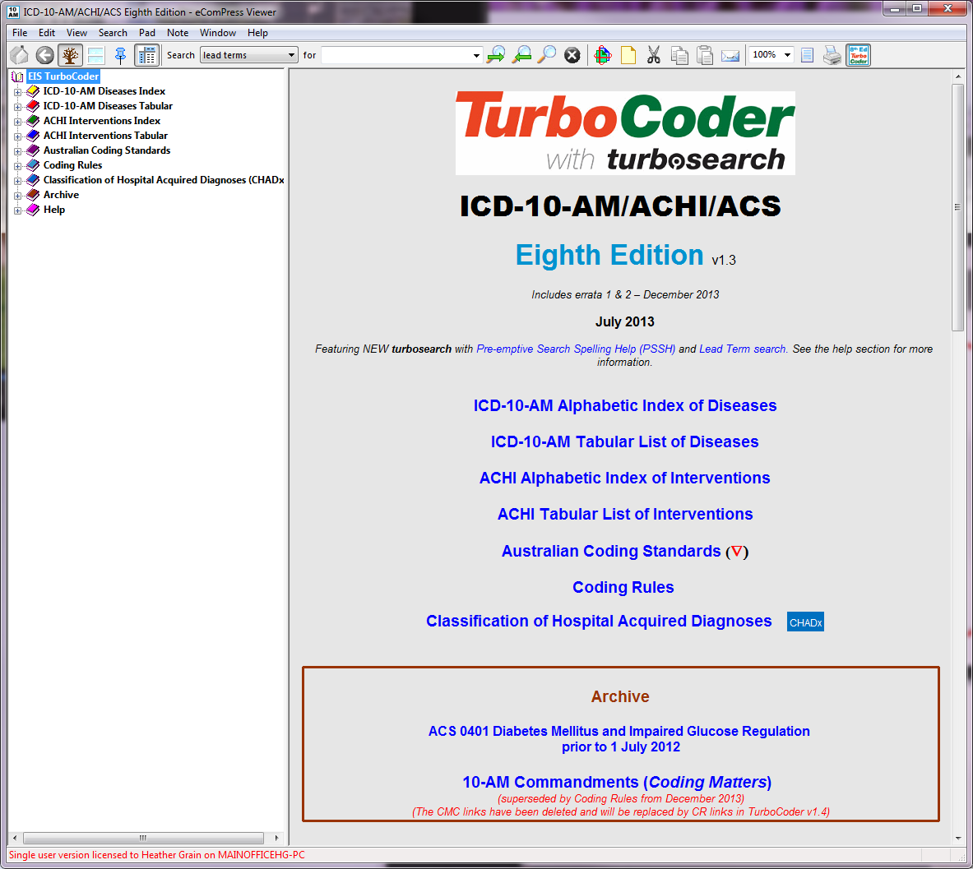
The Main Screen
Code Book Window -
shows the actual content what you would see if you opened a page in the paper books.

Slide 5
The Main Screen
Navigation Window –
Shows where you are in the books, or to select to go to a specific book or chapter

Slide 6
The Main Screen
Menu Bar
Supports searching and use of features of the tool.

Slide 7
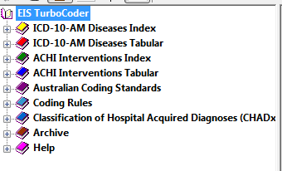
Navigation Window
Starting Point
List of the books and content and
Help in using the tool

Slide 8
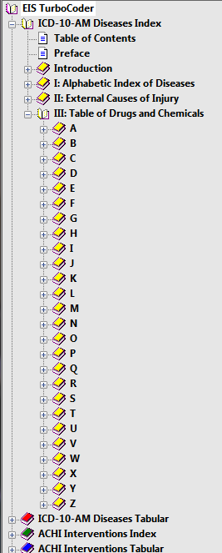
Navigating
Click to open +
Click to close –
Notes:
You may move through the code books by navigation (exactly as you would if you were using the paper based code books).

Slide 9
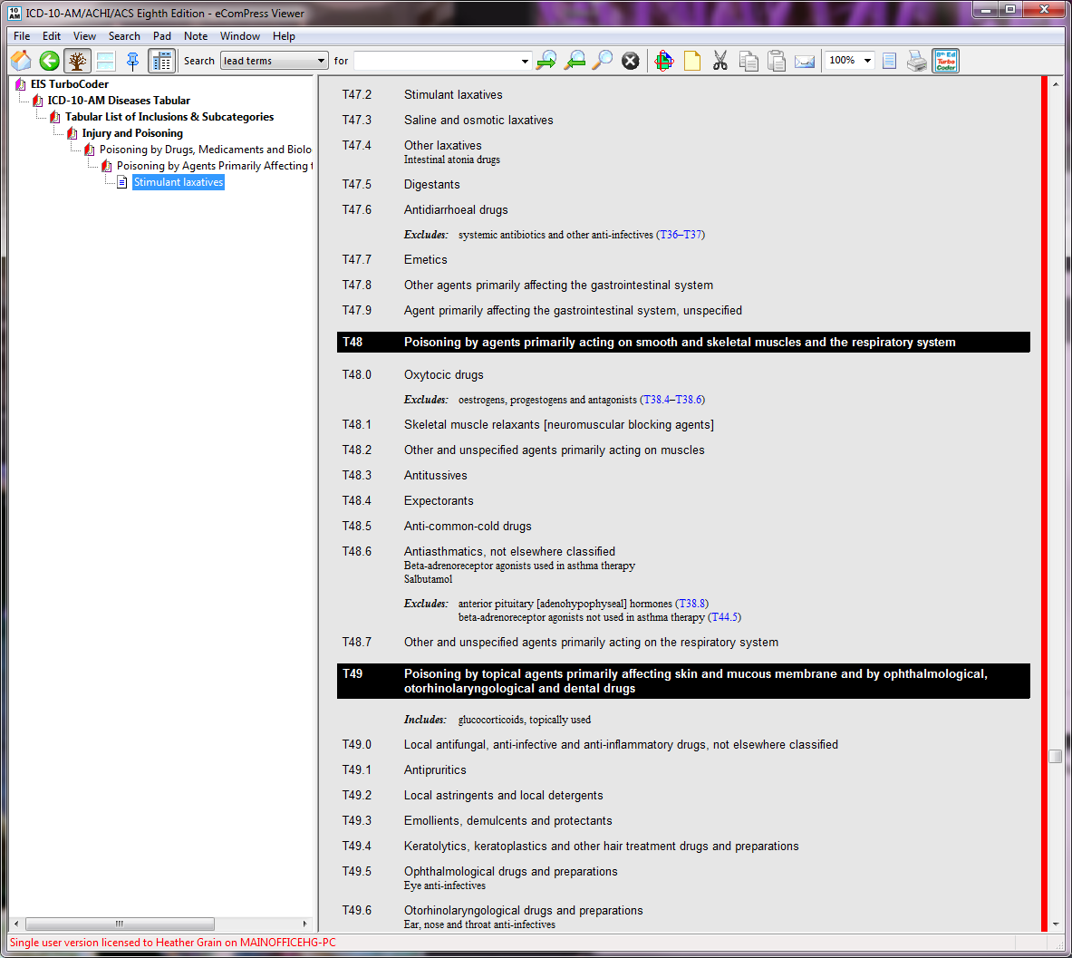
Automatic Navigation
As you make selections in the Code Books window the navigation bar changes to indicate where you are.
Notes:
As you make selections in the Code Books window the navigation bar changes to indicate where you are

Slide 10
The Main Screen
Menu Bar
Supports searching and use of features of the tool.

Slide 11
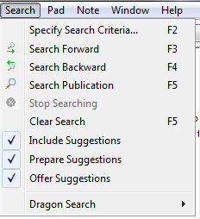
Searching
The Menu Bar includes a search section
And
A search drop down menu with hot keys

Slide 12
Search Type
Lead terms - the key (first level) entries in the index books.
Everywhere – the term anywhere in the code books.
Code – the code in the tabular lists of the code books
Standards Numbers – code standards in the Australian Coding Standards

Slide 13
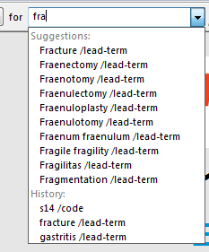
Searching for…
Enter a term or code in the ‘for’ section the system will look for that term using which ever search type you have selected.
The search will also display options as you to select from as you enter the text

Slide 14
Search – other functions
Right search arrow – will go to the next occurrence meeting the search criteria
Left search arrow – will go the previous occurrence meeting the search criteria

Slide 15
Changing the display
There are 4 different views. These views allow you to see different pages of the code book at the same time.
You may see 1,2,3,or 4 windows of the code books. The navigation bar will show navigation for the selected window

Slide 16
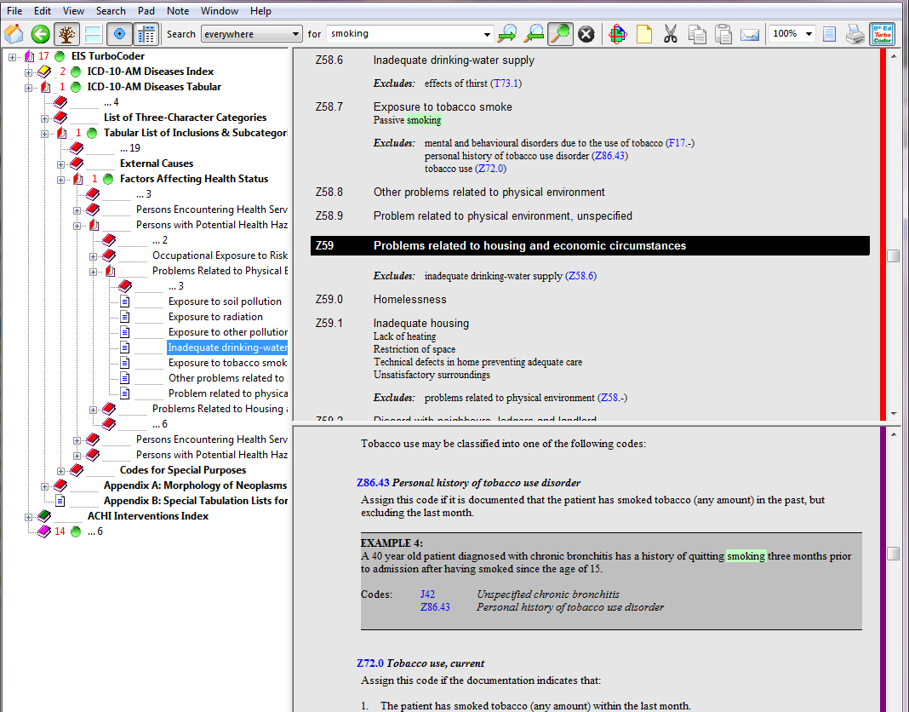
Notes:
For example the index and the code book page to which the index relates, and the standard relevant to the code which you are considering.
Top shows the code book for smoking the bottom the standard relating to smoking
You must select the relevant window and search will show result in the selected window.

Slide 17
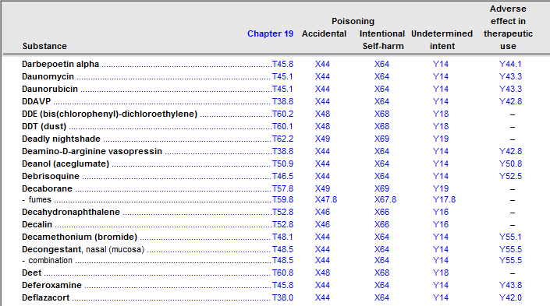
Freezing Table Headings
In an index table – click on the table window and then the Freeze Icon in the menu (above)
This will
freeze the
headings and
you can scroll
through the
table.

Slide 18

Making Notes
You can add comments, reference documents and coding rule notes to the tool.
Notes establish a ‘pad’ of comments and documents which can be added and edited.
The icon circled opens all notes for review or update.

Slide 19
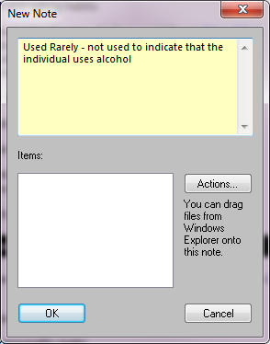
Adding a note
Type your notes in the top section
You may add content from the internet, attach files etc – click on the action button
Scissors can cut notes, you may copy them and email them using the other icons in the menu bar

Slide 20
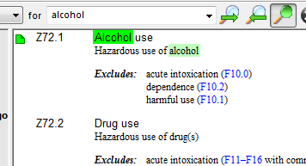
What does a note look like?
A note is seen as a small piece of paper icon next to the content with which it is associated.

Slide 21

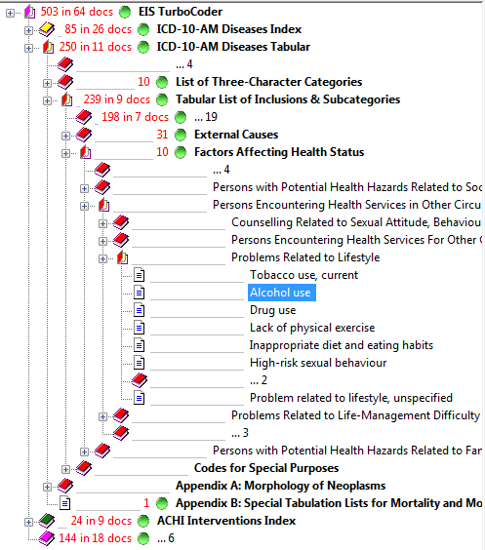
Other navigation features
Back Arrow – Main menu - takes you back one screen
Tree – pruning tool
This tool modifies the navigation view to show the whole tree or just the hierarchy within which you are currently looking.
The view on the left is a pruned view for Z72.1 alcohol use

Slide 22

Other Features
Zoom in and out using the 100% view icon,
The print preview icon is in the middle
The print page icon or print selection are managed using the printer icon.
These operate in the same manner as other software

Slide 23
Questions
Contact:
Heather Grain
0413 155 105
h.grain@ehe.edu.au

